Slide 1
Data Analysis Project 1.
Predicting Stock Returns Using Machine Learning
Oct 27, 2024
Group Members: Kai Ren, WeiJie Zhang, Yang Lan, YiMing Jiang, Rui Hu

Slide 2
Data Analysis Framework
Component Stocks of CSI500
Collecting Dataset
Factor Engineering
Training Model
Backtesting
Daily & Min Trading
Data
Fundamental
Data
Macro
Data
Factors Importances Analysis
Daily Trading
Factors
Fundamental
Factors
Macro
Factors
Return
Labels
Factors Importance
Select & Normalize
Machine Learning Models 🔥
Adjustance for
Less Overfitting
MLP
LSTM
···
Conv
Trained Models ❄️
Future Return
Prediction
Market Actions
Backtesting
MLP
LSTM
···
Conv
Fig 1. The Framework of Data Analysis Project 1.

Slide 3
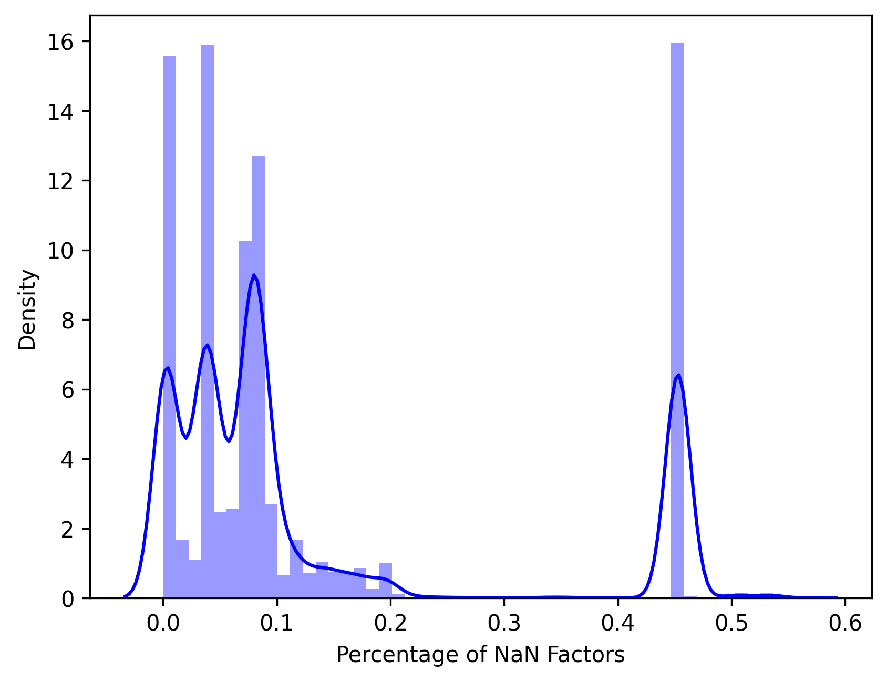
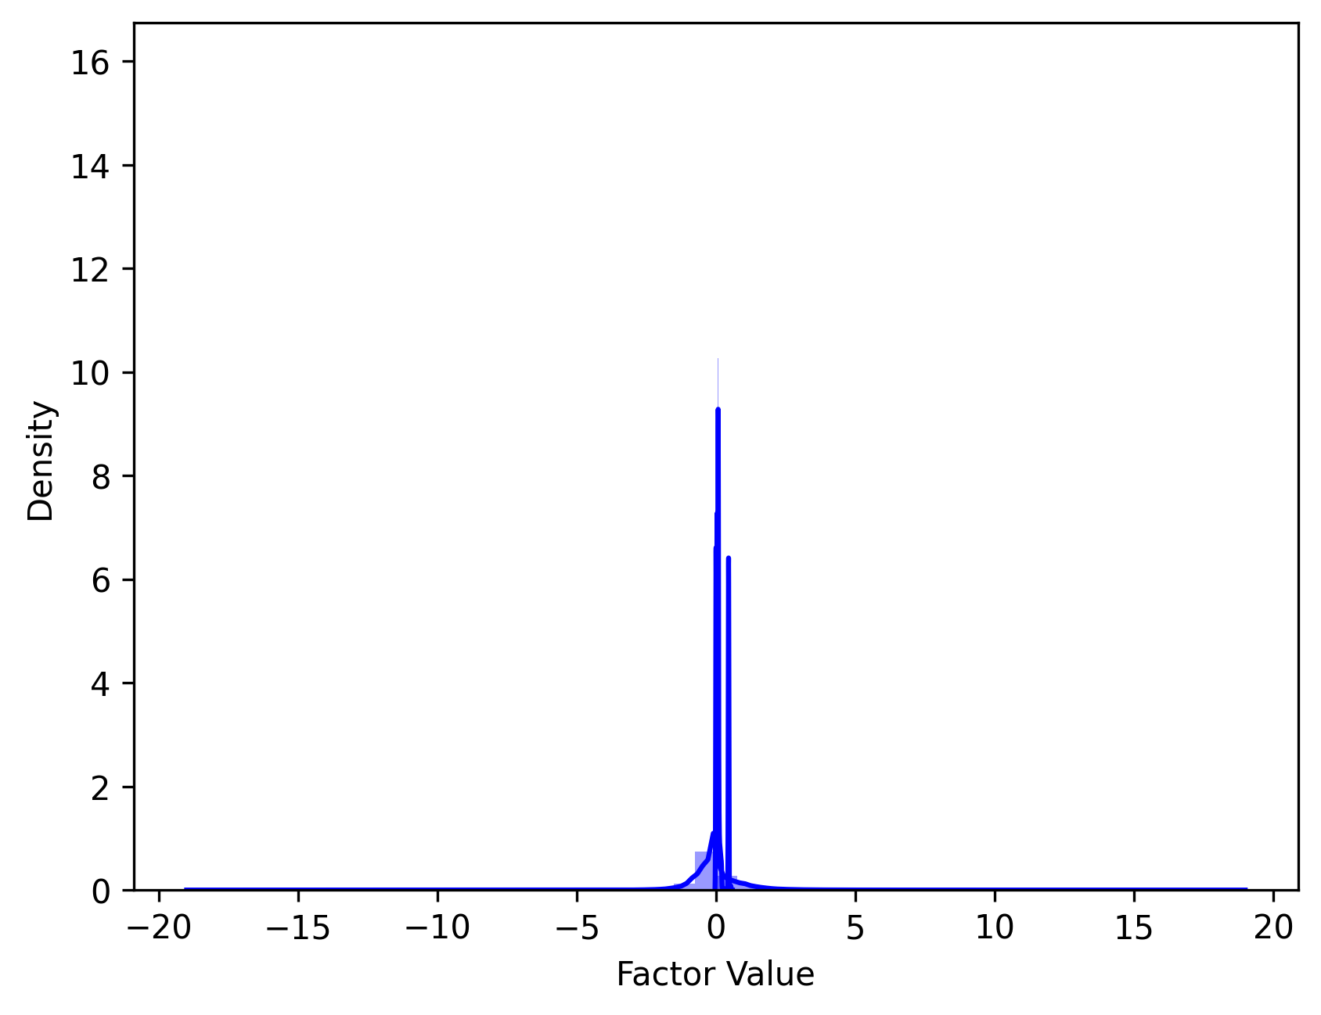
3.1 Select & Normalize
Raw Samples
(500 stocks, 606475 samples)
Samples have
NaN Label
Samples have too many NaN Factors
Slected Samples (Fill NaN by 0)
(360 stocks, 449765 samples)
Cross Sectional
Z-Score Normalization
Normed Samples
Fig 2. The Distribution of Nan Factors Percentage. We dropped samples where the percentage of NaN factors was greater than 10%.
Fig 3. The Select & Normalize Workflow. We also present the normed data distribution here.

Slide 4
3.2 In-Sample & Out-Sample Modeling
Normed
Factors
Daily Return
Label
Normed Samples
Train
Valid
Test
or
Discrete:
0-decrease; 1-no change; 2- increase
MSE Loss
CE Loss
Regression Modeling
Classification Modeling
Return Prediction
Discrete Prediction
All Samples to Train/Valid/Test
➸ In-Sample Modeling
Use Label to
Compute Metrics
Split to Train/Valid/Test
➸ Out-Sample Modeling
F1 Score & ACC
Fig 4. In-Sample and Out-Sample Modeling Framework.

Slide 5
3.2.1.1 In-Sample ”Perfect” Modeling Method
Normed Samples
Stock 1
Regression Model 1
100%
F1
& ACC
Both regression and classification models have a larger number of parameters than the training sample data.
They are theoretically able to memorize data !
Classification Model 1
Normed Samples
Stock 2
Regression Model 2
Classification Model 2
···
Normed Samples
Stock 360
Regression Model 360
Classification Model 360
Fig 5. Theoretically perfect way of In-Sample modeling.
This doesn't make sense for predictions, but is very helpful for checking code.

Slide 6
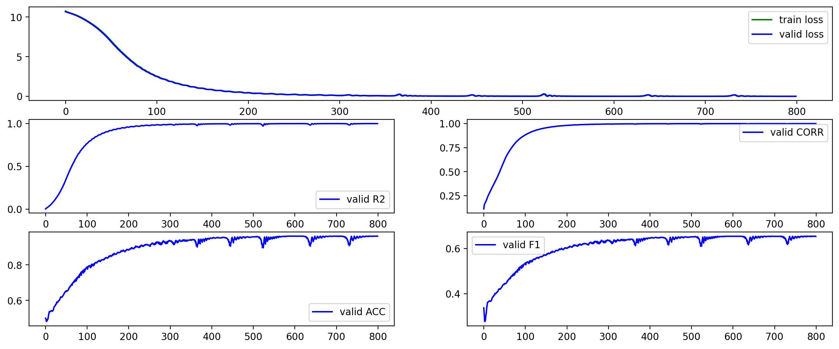
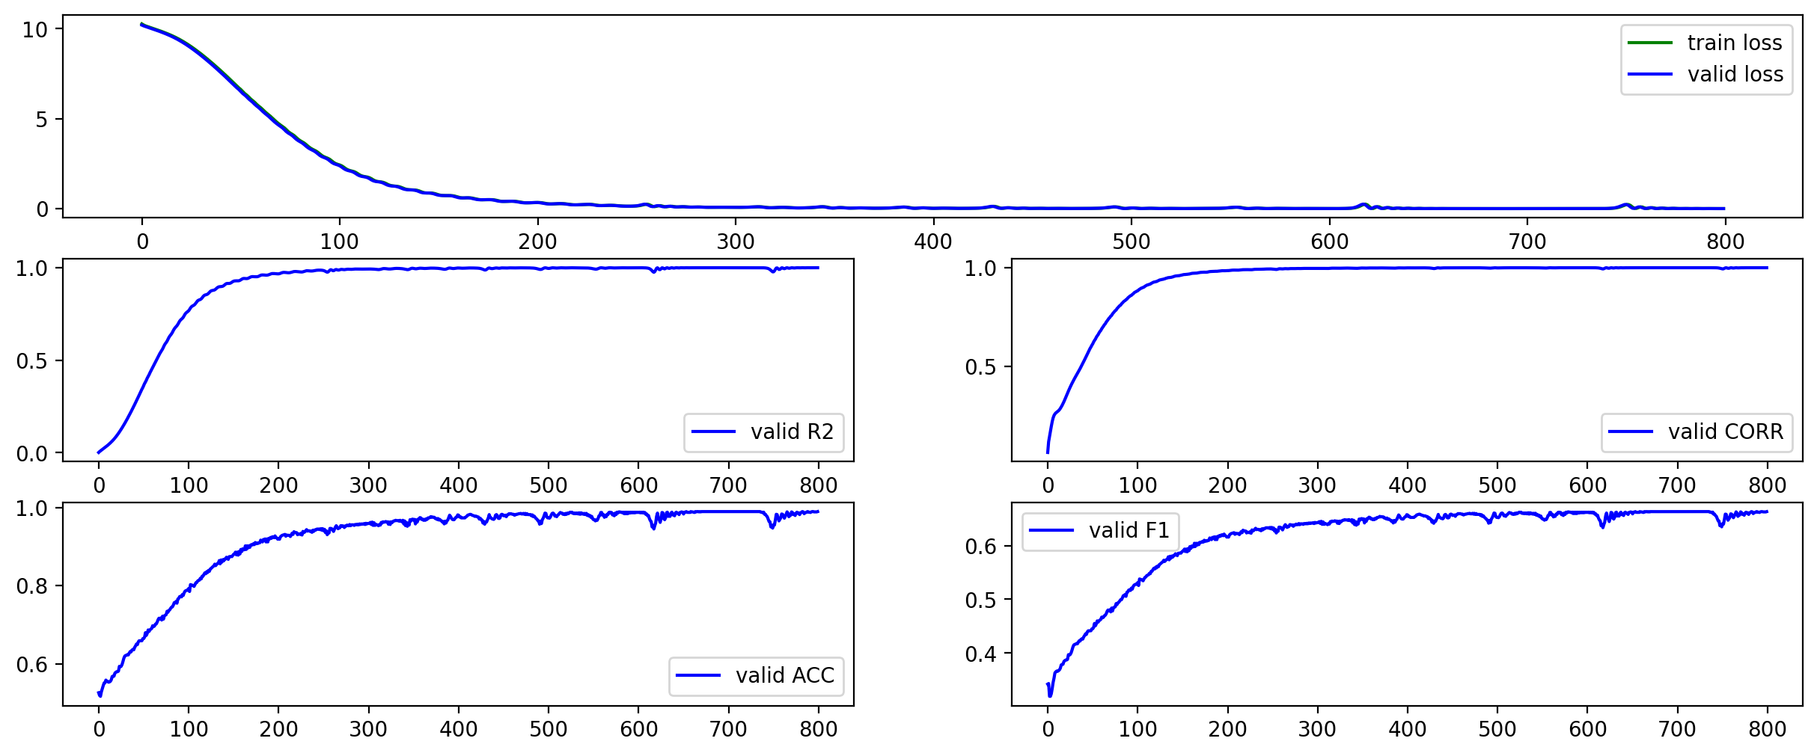
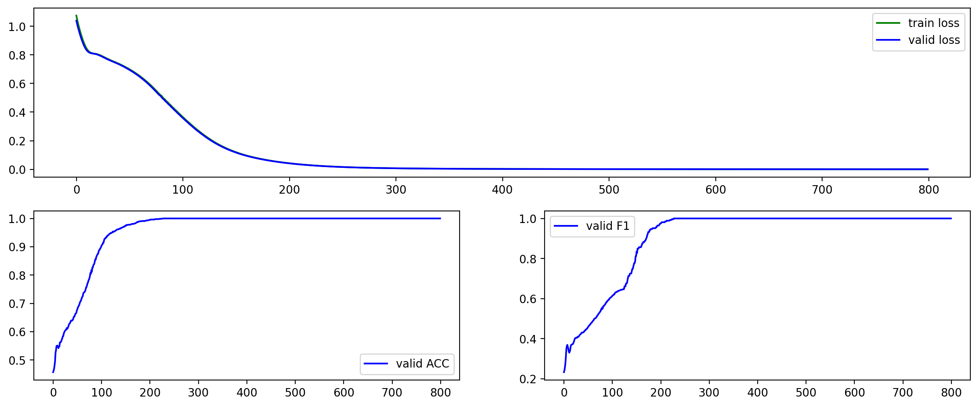
3.2.1.2 In-Sample ”Perfect” Modeling Result
000009.sz
000021.sz
Regression Modeling: ACC = 0.96, F1 = 0.65
Regression Modeling: ACC = 0.99, F1 = 0.66
Classification Modeling: ACC = 1.00, F1 = 1.00
Classification Modeling: ACC = 1.00, F1 = 1.00
Fig 6. In-Sample Modeling Result. We got the theoretically “perfect” result.
Why there is no perfect ACC and F1 when use Regression Modeling ?

Slide 7
3.2.1.3 In-Sample Overall Stocks Modeling Result
MLP
Big_MLP

Slide 8
3.2.1.3 In-Sample Overall Stocks Modeling Result
Conv

Slide 9
3.2.2.1 Out-Sample ”Perfect” Modeling Method ?
Regression Model 1
Train
Valid
Test
Classification Model 1
100% F1 & ACC ?
Regression Model 2
Train
Valid
Test
Classification Model 2
Both regression and classification models have a larger number of parameters than the training sample data.
···
Regression Model 360
Train
Valid
Test
Classification Model 360
Fig 8. Single Stock Out-Sample Modeling.

Slide 10
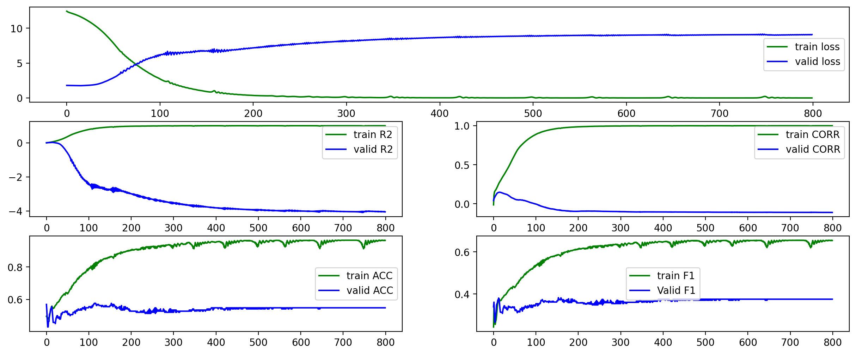
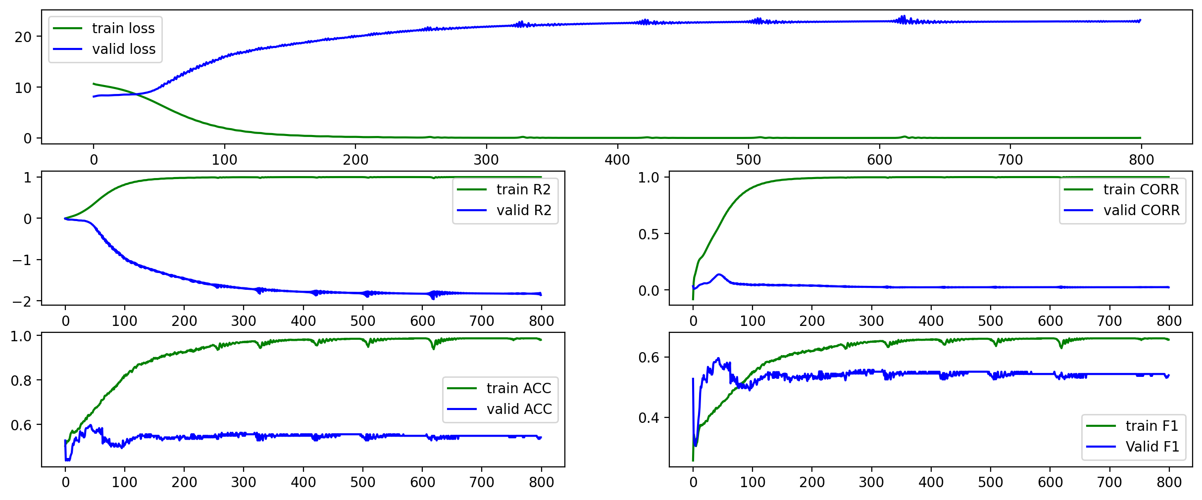
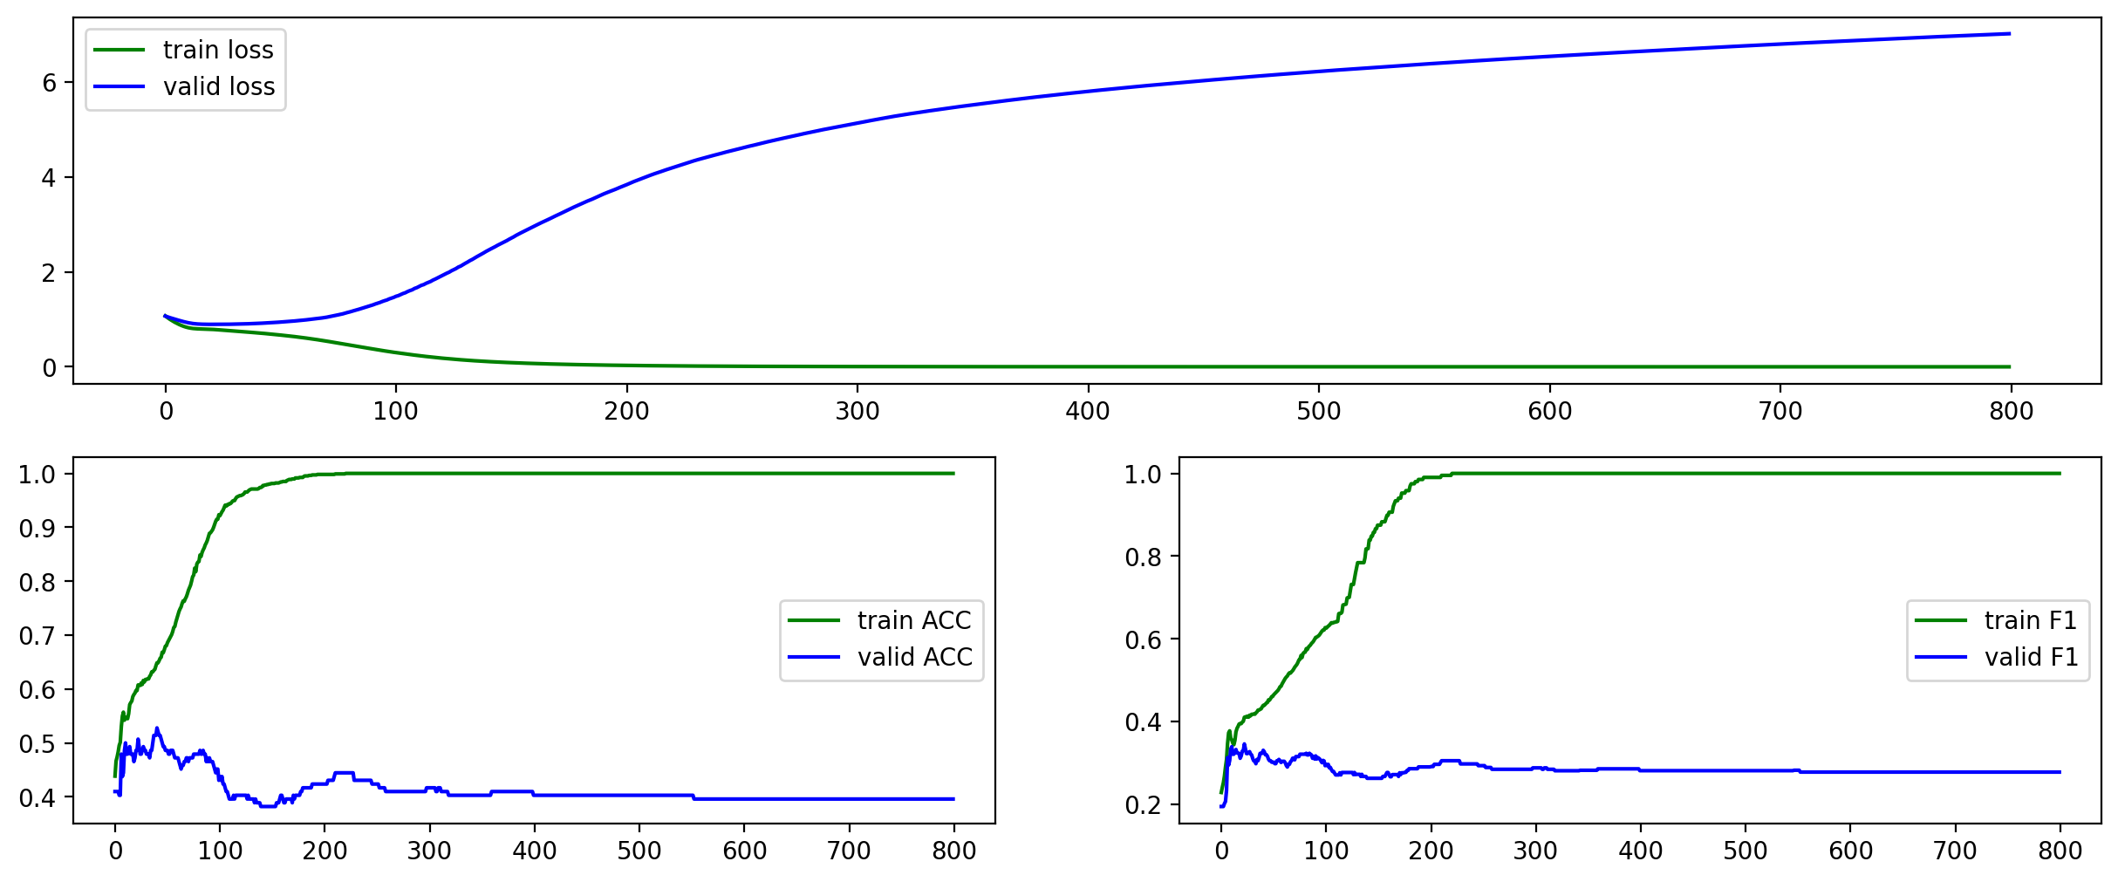
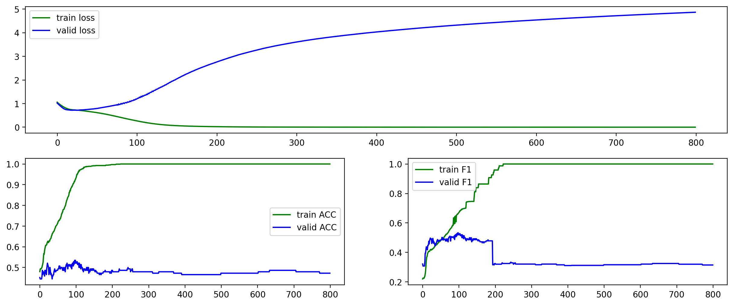
3.2.2.2 Out-Sample ”Perfect” Modeling Result
000009.sz
000021.sz
Regression Modeling: Test - ACC = 0.44, F1 = 0.29
Regression Modeling: Test - ACC = 0.52, F1 = 0.52
Classification Modeling: Test - ACC = 0.53, F1 = 0.34
Classification Modeling: Test - ACC = 0.48, F1 = 0.46
Fig 9. The Result of Single Stock Out-Sample Modeling.
No perfect ACC and F1 ANYMORE!

